Slide 1

Yelp Dataset Sentiment Analysis
Phase 2: Project Plan
Cole Hanrahan and Julia Sober
COSC 5540 — Text Mining & Analysis
Fall 2025

Slide 2
Literature Review Recap
Motivation:
Star ratings summarize satisfaction but are subjective and inconsistent.
Automatically predicting ratings from text helps:
Users gauge sentiment quickly
Businesses identify improvement areas
Researchers study drivers of satisfaction
Findings:
Binary sentiment classification (positive vs. negative) → High accuracy (≈ 90%)
Multi-class star prediction (1–5) → Lower accuracy (≈ 60–65%)
Best features: TF-IDF + n-grams
Best models: Logistic Regression, SVM
Deep models (CNNs, Bi-LSTMs, BERT) show promise but struggle with:
Middle ratings (2–3 stars)
Imbalanced data (too many 4–5s)
Sarcasm and slang
Key Gaps:
Context understanding still limited (“Great job burning my pizza!”).
4–5 star dominance causes skewed learning.
Ordinal sentiment analysis under-explored.
Deep models improve nuance but need more explainability.

Slide 3
Project Goal + Research Focus
Project Type: Innovation – New Model & Evaluation
Research Questions / Goals:
Can pretrained BERT embeddings be leveraged to improve Yelp review star rating prediction beyond traditional methods?
Does a multi-task learning approach that predicts sentiment and star rating jointly outperform separate models or layered classifiers?
How do different modeling strategies (layered classifiers, baseline embeddings, multi-task BERT) compare in terms of accuracy, macro-F1, and per-class performance?
Planned Approach:
Baseline Models: TF-IDF + Logistic Regression / Random Forest / SVM / Ordinal Regression
Layered Classifier: Hierarchical sentiment → star rating
Multi-Task Model: Shared BERT embeddings → separate sentiment & star rating heads
Evaluation: Compare all models on accuracy, macro-F1, and confusion matrices
Expected Contribution / Innovation:
Introducing a multi-task BERT-based architecture for Yelp review analysis.
Comprehensive comparison between traditional methods, layered classifiers, and modern embedding-based models.

Slide 4

Data Preparation
Dataset: Yelp Open Dataset (subset: specific state restaurant reviews).
Tasks:
Filter restaurant reviews.
Clean and normalize text (lowercasing, punctuation removal, stopword removal).
Derive auxiliary features (e.g., review length, punctuation counts).
Output: Cleaned, balanced dataset ready for modeling.
Source: Columbia University

Slide 5
Modeling Approaches + Preliminary results

Slide 6
Baselines w/ TF-IDF + n-grams
Input Features: TF-IDF vectors of clean Yelp review text (unigrams + bigrams, max 10k features)
Models Implemented:
Logistic Regression
Naive Bayes
SVM (Linear)
Random Forest
Ordinal Logistic Regression
Output:
Binary sentiment classification (negative / neutral / positive)
1–5 star rating prediction
Key Notes:
Quick to train, interpretable
Performance serves as a baseline for comparison

Slide 7
Results (subsample n=500,000)
Features = Unigram + Bigram + TF_IDF w/ max_features = 10,000
Model | Classification Type | Accuracy (%) | Macro-F1
Logistic Regression | 1-5 RRP | 67.66 | 0.5969
Naive Bayes | 1-5 RRP | 64.15 | 0.5187
SVM | 1-5 RRP | 44.70 | 0.4147
Random Forest | 1-5 RRP | 51.96 | 0.2869
Ordinal Logistic Regression | 1-5 RRP | 60.92 | 0.5268
Logistic Regression | Pos. / Neu. / Neg. | 87.43 | 0.7398
Naive Bayes | Pos. / Neu. / Neg. | 84.45 | 0.6494
SVM | Pos. / Neu. / Neg. | 60.63 | 0.5081
Random Forest | Pos. / Neu. / Neg. | 75.83 | 0.4622
Ordinal Logistic Regression | Pos. / Neu. / Neg. | 85.66 | 0.7133

Slide 8
Baselines w/ Pre-trained Sentence Embeddings
Input Features:
Sentence embeddings from pre-trained models (sentence-transformers)
Each review converted to a fixed-length vector representing semantic content
Models Implemented:
Logistic Regression
Naive Bayes
SVM (Linear)
Random Forest
Ordinal Logistic Regression
Output:
Binary sentiment classification (negative / neutral / positive)
1–5 star rating prediction
Key Notes:
Embeddings provide richer semantic features than TF-IDF
Simple classical ML models are easier to train on embeddings
Serves as a bridge between TF-IDF baselines and BERT-based layered / multi-task models

Slide 9
Results (subsample n=500,000)
Features = sentence_transformers
Model | Classification Type | Accuracy (%) | Macro-F1
Logistic Regression | 1-5 RRP
Naive Bayes | 1-5 RRP
SVM | 1-5 RRP
Random Forest | 1-5 RRP
Ordinal Logistic Regression | 1-5 RRP
Logistic Regression | Pos. / Neu. / Neg.
Naive Bayes | Pos. / Neu. / Neg.
SVM | Pos. / Neu. / Neg.
Random Forest | Pos. / Neu. / Neg.
Ordinal Logistic Regression | Pos. / Neu. / Neg.

Slide 10
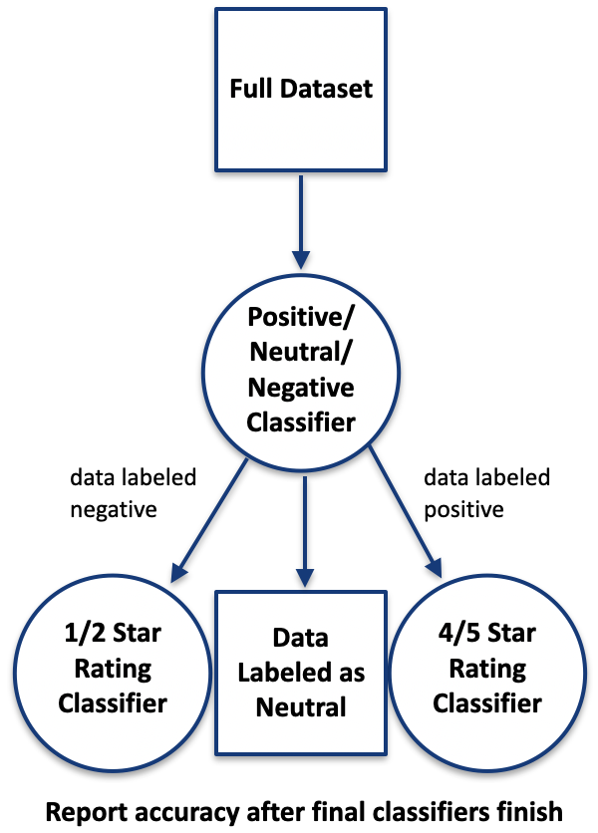
Layered Classifier with TF-IDF + n-grams & Logistic Regression
Architecture: Hierarchical classifier
Stage 1: Sentiment classification (negative/neutral/positive)
Stage 2a: Negative reviews → 1 vs 2 stars
Stage 2b: Positive reviews → 4 vs 5 stars
Neutral reviews → automatically assigned 3 stars
Input Features: TF-IDF vectors of review text
Output: 1–5 star rating
Key Notes:
Slightly better than baseline in some classes, worse in others, but limited improvement overall (< 0.02%)

Slide 11
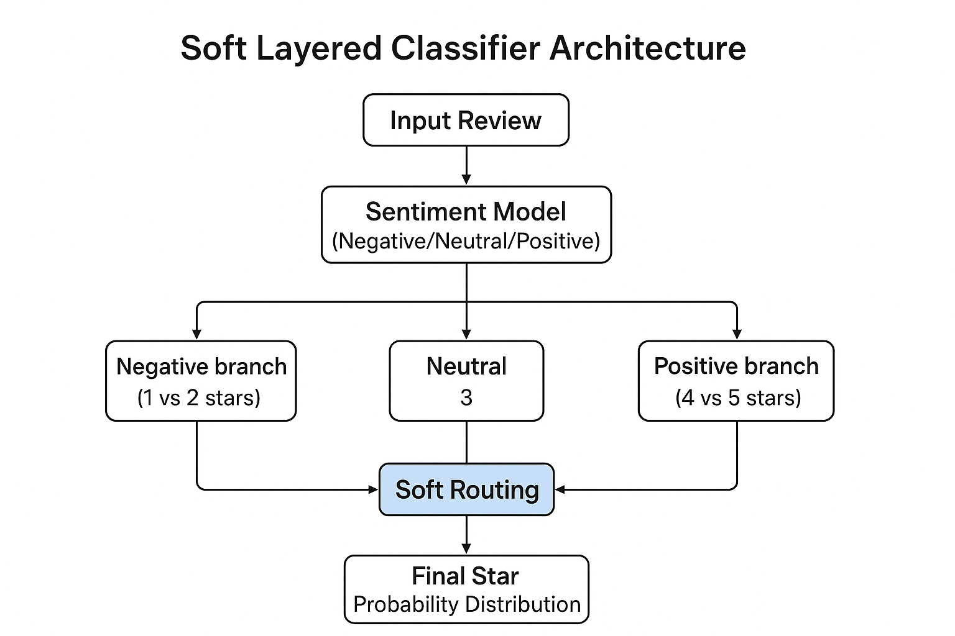
Layered Classifier with Pre-trained Embeddings + Soft Routing & Logistic Regression
Architecture:
Pre-trained BERT embeddings for text
Soft routing to 3 sub-models: negative, neutral, positive
Each sub-model predicts 1–2 or 4–5 stars; neutral = 3 stars
Input Features: CLS token embeddings from BERT
Output: 1–5 star rating
Key Notes:
Embeddings provide richer semantic understanding than TF-IDF
Still uses hierarchical routing but leverages pre-trained language model
Passes soft probabilities from layer 1 → layer 2 to avoid error propagation

Slide 12
Simple BERT + MLP
Architecture:
BERT (pre-trained, frozen) → outputs 768-dimensional CLS embedding.
Dropout + Fully Connected Layer (FC1) + ReLU → compress to 256 dimensions.
Dropout + Fully Connected Layer (FC2) → output 5 classes (1–5 stars).
Key Notes:
Only the MLP layers are trained; BERT weights remain frozen.
Simple architecture serves as a baseline for comparing more complex models.
Useful for evaluating if pre-trained embeddings alone provide strong predictive power

Slide 13
Multi-Task BERT Model (Shared Embeddings)
Architecture:
Pre-trained BERT → shared 256-dim hidden layer
Two output heads:
Sentiment (3 classes)
Star rating (5 classes)
Input Features: CLS token embeddings from BERT
Output:
Joint prediction of sentiment and star rating
Key Notes:
Learns shared representation for both tasks
Enables simultaneous optimization and potential performance gains
Can analyze correlation between sentiment and star predictions

Slide 14
Project Status
Already Completed
Data collection/wrangling
Preprocessing
Model pipelines built + tested:
Baselines with TF-IDF
Baselines with embeddings
Layered classifier with TF-IDF
Pipelines (mostly) built (not yet tested):
Layered classifier with embeddings + soft routing (probability-based)
Simple MLP + BERT (2 layers)
Multi-task BERT model (shared embeddings → sentiment & star heads)
In Progress
Test (run) models (will take a few days):
Layered classifier + soft routing
Simple MLP + BERT
Multi-Task BERT model
Evaluation & comparison across all models
Will be easy to do once done running
Hyperparameter tuning and model adjustments
1 week for tuning + rerunning
Visualization of results (confusion matrices, metric tables)
Couple hours
Not Started
Report + presentation slides
Additional analysis:
Per-class performance
Error analysis
A week or so

